Slide 1
STUDENT RESULTS MANAGEMENT SYSTEM
CO225 GROUP PROJECT
GROUP 08
E/18/028 – Ariyawansha P.H.J.U.
E/18/173 – Kasthuripitiya K.A.I.M.
E/18/285 – Ranasinghe S.M.T.S.C.

Slide 2
Content
Application Content
System Organization
Flow of Data through the system
Technology Stack
Project Plan
Additional Features
Team & progress

Slide 3
Application Content
FOR WHAT?
To independently manage, analyze, and predict the grades of undergraduate students
FOR WHOM?
Without the involvement of instructors or lecturers, undergraduate students use it on their own.
WHY?
To keep track of information such as results, progress, students, courses, and exams.
To minimize the amount of time spent manually managing results, activities, and details of students.
To keep track of all the information regarding the student's course and exams.
To get idea about their performance

Slide 4
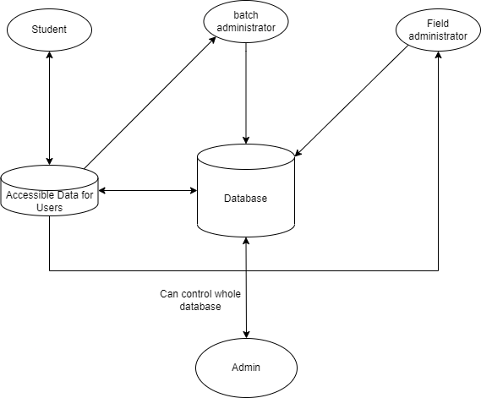
System Organization

Slide 5
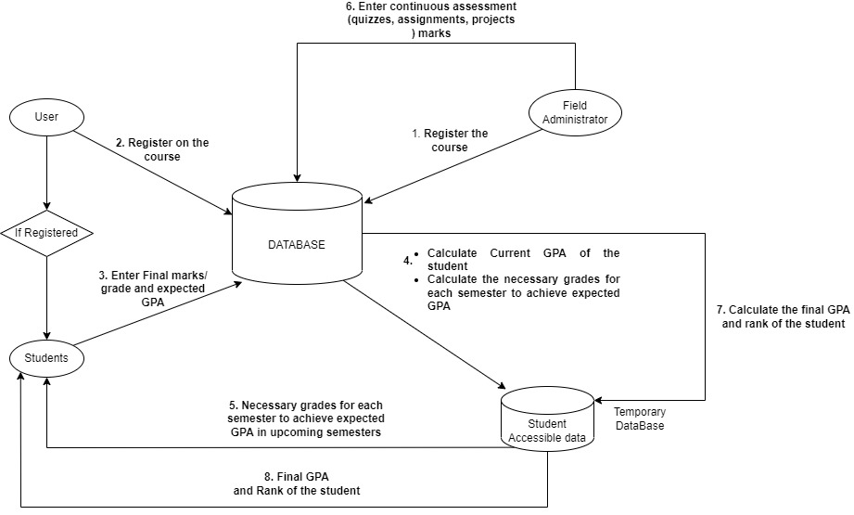
Flow of Data through the System

Slide 6

Technology Stack
Android Studio
This is devoloped by Android Studio
Used Android version 9.0 (Pie) as minimum android version that supports this app.
This app run approximately 69% of Android devices around the world

Slide 7

Technology Stack
JAVA
All the front-end logic has been written in Android Java
OOP techniques are used to reduce complexity of classes
Used to connect back-end with UI of the app

Slide 8

Technology Stack
MySQL
This is used as an open-source relational database management system
All the back-end of application managed in here using table structure
The WebAPI is deployed using the Apache server

Slide 9
Project Plan
 | Week
 | 1 | 2 | 3 | 4 | 5 | 6 | 7 | 8 | 9 | 10 | 11 | 12 | 13 | 14
Solution Architecture
Designing UI
Exam break
Designing the database
Connecting Database
Testing
Additional Features

Slide 10
Additional Features
Can get final outcome as pdf report
Visualize the marks with course average marks
Import/ Export locally unique files for app

Slide 11
Team & Progress
Use GitHub to work as a team
All the users have access to the GitHub repo and can work on different branches and commit changes to the main
By working as a team, minimize the time required to complete the project

Slide 12
Thank You!
👍

